Slide 1
Workload solution Demo #1
Xiaogang Zhou, Feng Xia
4/7/2017

Slide 2
Agenda
Charm intro
Charm deploy
Charm development
Charm chained states
Charm hooks
CentOS compatibility

Slide 3



Juju+MaaS setup
VM #1
Issue JUJU CLI
Management network
10.240.216.0/23
MaaS provider
MaaS REST API
MAAS
rack controller
VM #2
Provision network
192.168.100.0/24
Workload
XYZ
JUJU
Machine-0
Manager node
VM #N
VM #3
JUJU
GUI
VM #4
BM

Slide 4
Juju+LXD setup
Issue JUJU CLI
lxdbr0
veth
veth
veth
Container internal network
192.168.100.0/24
eth0
eth0
Workload
XYZ
JUJU
Machine-0
Manager node
CT #N
eth0
CT #3
JUJU
GUI
CT #4
LXD containers
VM #1

Slide 5
Charm intro

Slide 6
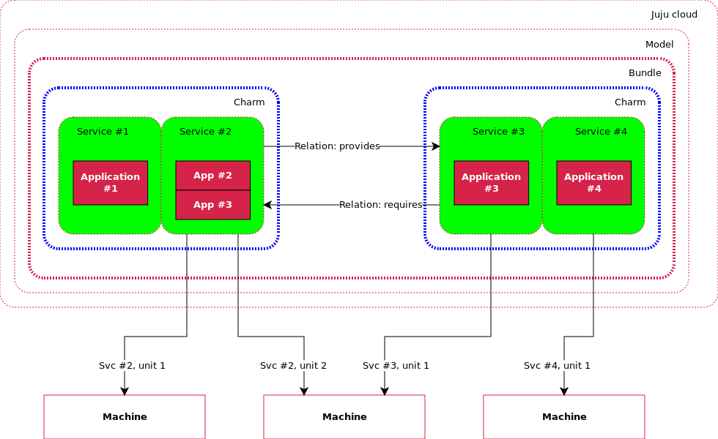
Charm intro
Workload charm
Base unit is a “service”.
Service can have more than 1 units to achieve HA.
Deployment can be on BM, VM, and LXD container.
High availability

Slide 7
Charm deploy

Slide 8
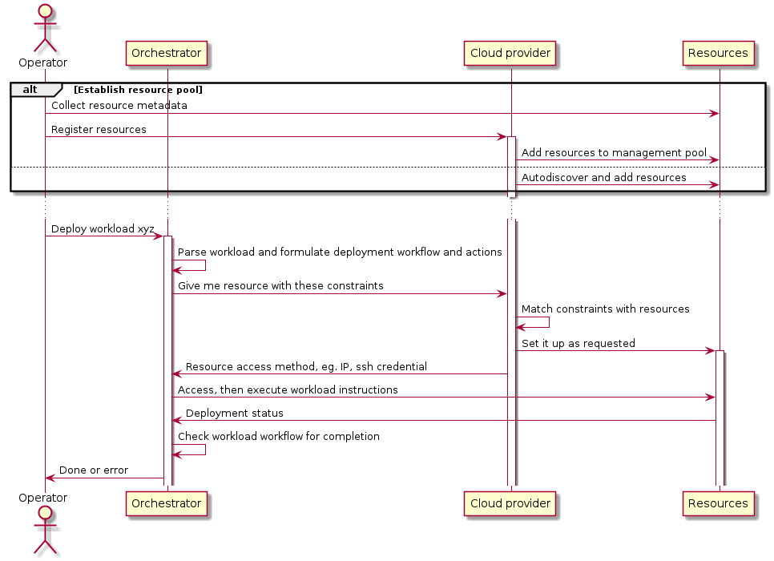
Deployment pattern 1 – pooled resource
Notes:
Pattern 1: resources metadata are registered before they become available for consumption, whereas in pattern 2 resource is created on the fly.

Slide 9
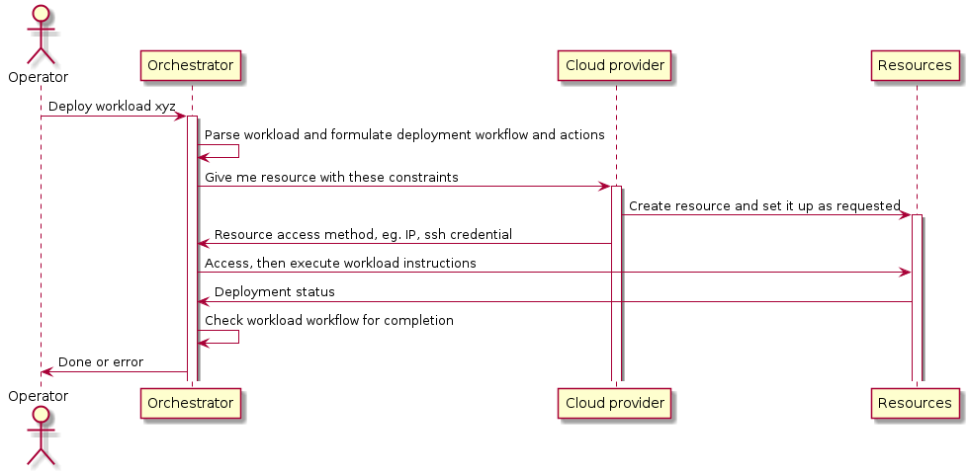
Deployment pattern 2 -- ondemand
Notes:
Pattern 2: is an ideal that resource can be created on the fly, which is observed in juju creating LXD container when deploying workload, eg. openstack base. In the end, we want the entire system appear to operator to have this capability by hiding complexity within the system.

Slide 10
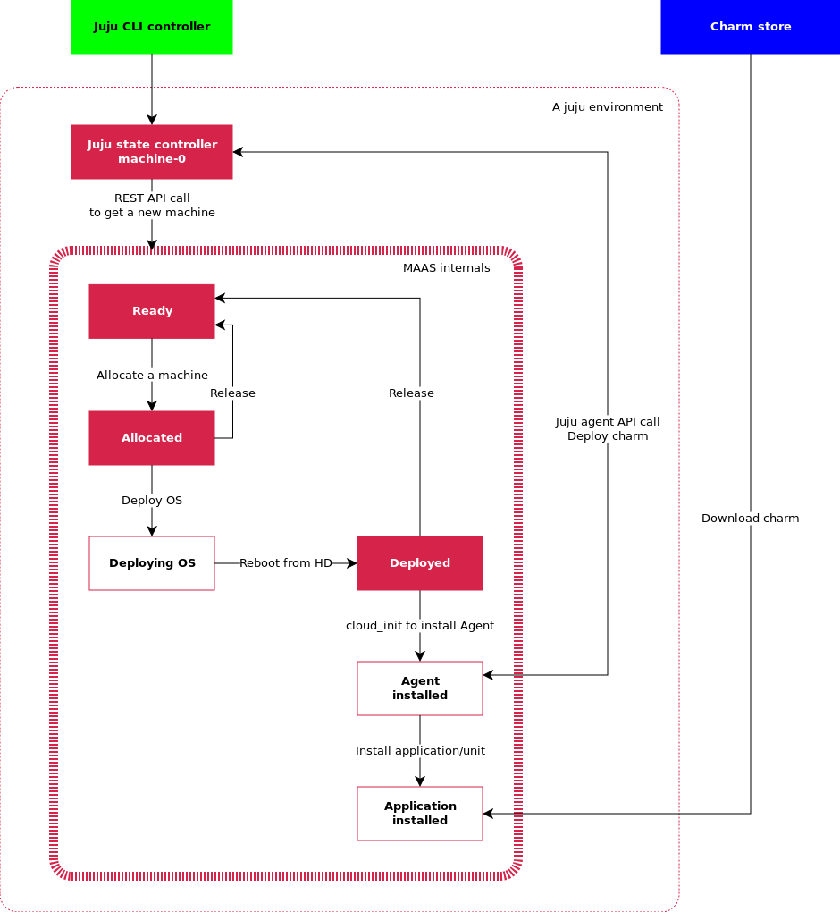
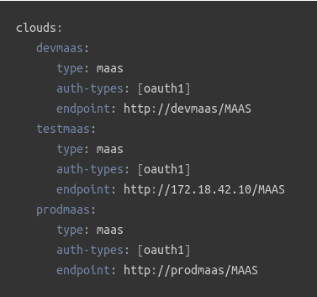
Pattern 1 example – Juju + MaaS
Prepare MaaS and BM nodes – NEW, commissioning, READY
Bootstrap Juju environment – create manager node, aka. Machine-0
To add a cloud:
$ juju add-cloud devmaas maas-clouds.yaml

Slide 11
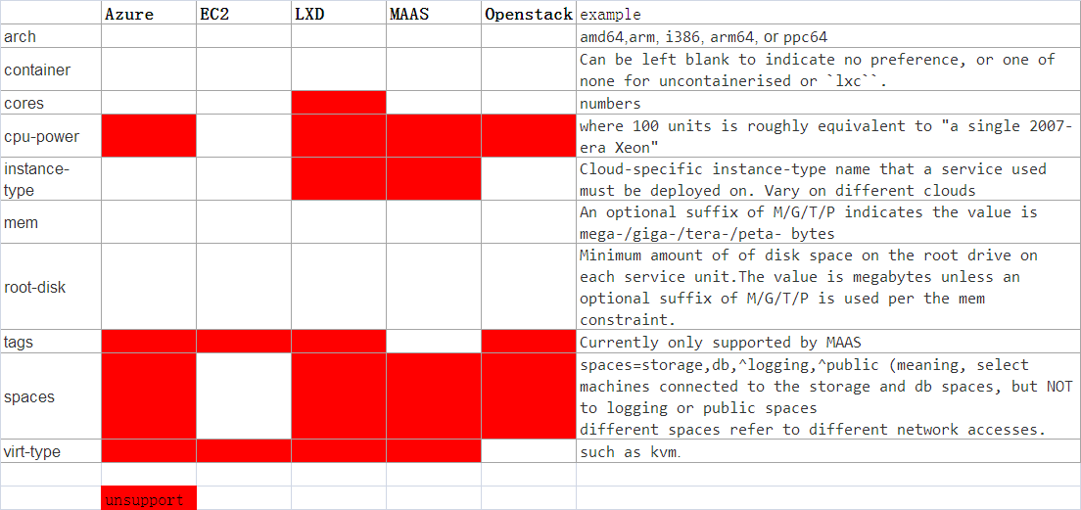
Constraints
E.g. --constraints mem=4G cores=2
Can also define different constraints sets for different clouds:Such as:arch,cores,mem,root-disk,virt-type
Notes:
Need to fingure out
{ "name":"default", "model-uuid":"719d9a06-3d86-44fa-8e4d-e65232c8a84c", "controller-uuid":"4b112187-fa26-401e-8116-e21ac2dd868a", "controller-name":"lxd-test", "owner":"admin", "cloud":"lxd", "region":"localhost", "type":"lxd", "life":"alive", "status":{ "current":"available", "since":"2017-04-06" }, "users":{ "admin":{ "display-name":"admin", "access":"admin", "last-connection":"1 hour ago" } }, "machines":{ "0":{ "cores":0 }, "1":{ "cores":0 }, "2":{ "cores":0 }, "9":{ "cores":0 } } }

Slide 12
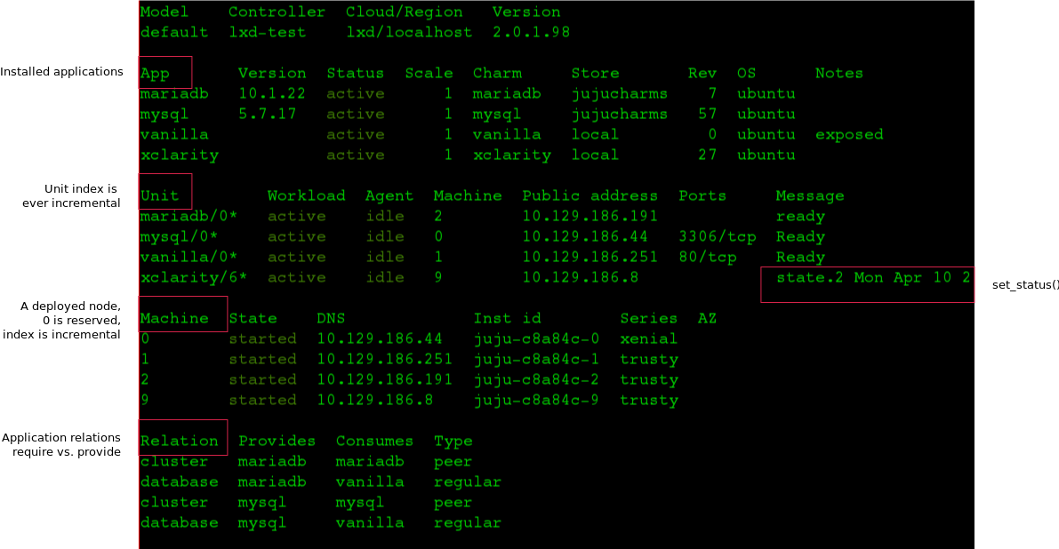
Juju status
Fig. $ juju status

Slide 13
Demo: charm deploy
Details of the charm that we will demo, use Openstack
Screencast a deploy process, including views from Juju GUI
Screencast

Slide 14
Charm development

Slide 15
Create charm
1,Two ways to get charms:
1,Can download charm from github and run charm build:
git clone http://github.com/juju-solutions/layer-vanilla.git
2,Use the charm tools to build up the charm src:
charm create -t reactive-python XXXX (this –t is the type of charm template we want to create, react is a very flexible way to write a charm)
2,Use the charm build to create a charm
3,Deploy local charm to certain machine
juju deploy $JUJU_REPOSITORY/trusty/layer-alum --series xenial –to machine-id

Slide 16
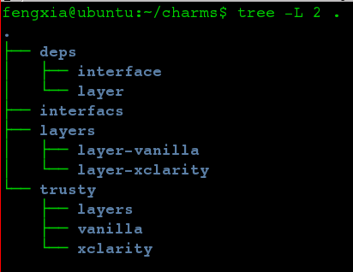
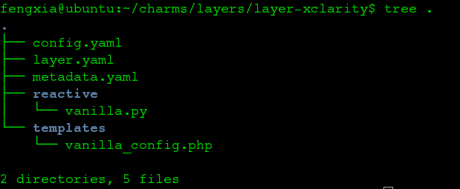
Code tree
config.yaml: config options
can be load in the python files to enable flexible config
metadata.yaml: charm meta
Defines info like what is the charm, works on which series
And what relationship this charm might involve
layer.yaml
Include layer:basic
List of reusable layers
This is like inject conceph, included layercan be used in the layer
(not shown) interface.yaml
- Require & provide (consider delete this?)
/reactive: custom code
Intro of charm-helpers
Intro of charm tools
Layer code
Built charm dir
Notes:
import yaml
import subprocess
from charmhelpers.core.unitdata import kv
from charmhelpers.core.hookenv import status_set
def config():
db = kv()
with open('django.yaml') as f:
django_cfg = yaml.safe_load(f.read())
for k, v in django_cfg.items():
db.set(k, v)
return db
def manage(cmd):
dcfg = config()
if not isinstance(cmd, list):
cmd = cmd.split(' ')
exe = [python(), 'manage.py']
extra = []
if dcfg.get('config-import'):
extra.append('--settings=%s' % dcfg.get('config-import'))
status_set('maintenance', ' '.join(['manage.py'] + cmd))
call(exe + cmd + extra)
def call(cmd):
dcfg = config()
subprocess.check_call(cmd, cwd=dcfg.get('source-path'))
def pip():
return config().get('pip', '/usr/bin/pip')
def python():
return config().get('python', '/usr/bin/python')
metadata
name: keystone summary: OpenStack identity service maintainer: OpenStack Charmers <openstack-charmers@lists.ubuntu.com> description: | Keystone is an OpenStack project that provides Identity, Token, Catalog and Policy services for use specifically by projects in the OpenStack family. It implements OpenStack’s Identity API. tags: - openstack - identity - misc series: - xenial - trusty - yakkety extra-bindings: public: admin: internal: provides: nrpe-external-master: interface: nrpe-external-master scope: container identity-service: interface: keystone identity-notifications: interface: keystone-notifications identity-admin: interface: keystone-admin identity-credentials: interface: keystone-credentials requires: shared-db: interface: mysql-shared pgsql-db: interface: pgsql ha: interface: hacluster scope: container domain-backend: interface: keystone-domain-backend scope: container peers: cluster: interface: keystone-ha

Slide 17
Charm chained states

Slide 18
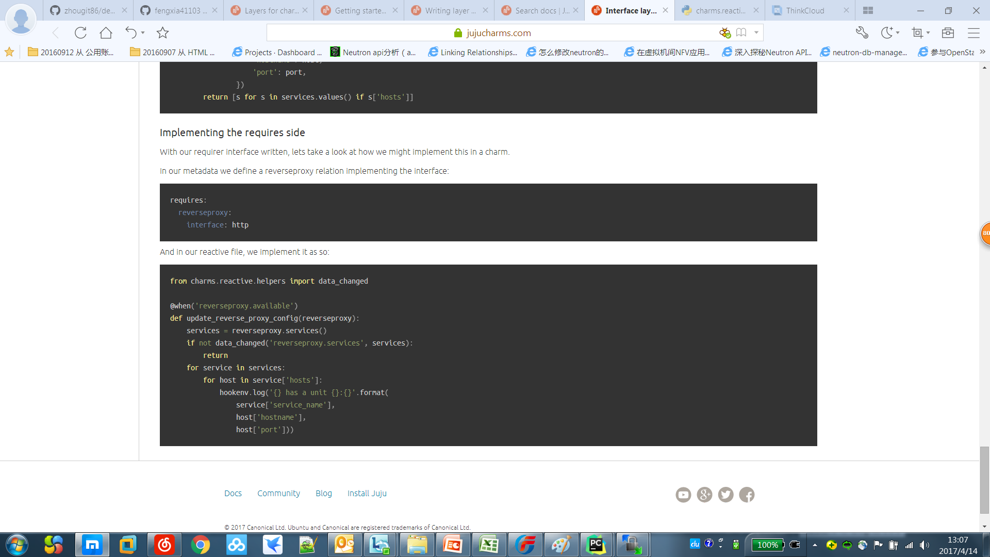
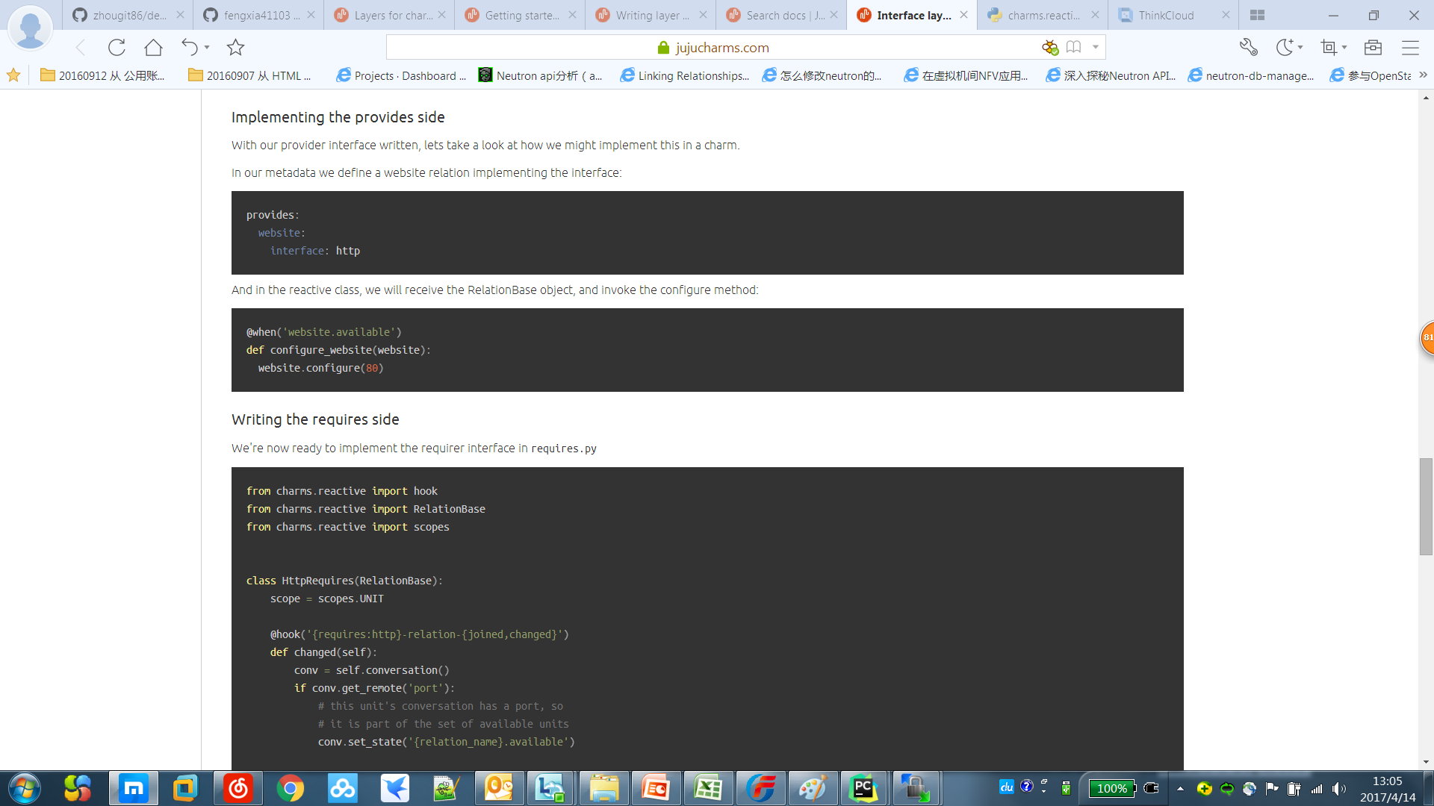
Chained-states
START
Intro of states
use @when and similar decorators to indicate that blocks of code react to certain conditions, such as a relation reaching a specific state, a file changing, certain config values being set, etc.
How are states executed?
Use @when/@when_not to trigger the Function, use set_state/remove_state to move to certain state
Who sets the “start”?
State is set in a provide layer and triggered in a require layer
set_state(‘state.1’)
State.1
set_state(‘state.2’)
State.2
set_state(‘state.1’)
set_state(‘state.3’)
State.3
Notes:
@when_not(‘a’)
Def this():
set_state(“b”)
pass
@when(‘b’)
Def that():
set_state(“c”)
pass
Import time
time.time() => 9834092492094.998
time.ctime(time.time()) => Fri 10:17 May 01, 2017
with open(“/tmp/juju.log”,’a’) as f:
f.write()

Slide 19
Demo: chained-states
Screencast

Slide 20
Charm hooks

Slide 21
Workload event lifecycle hooks
install
config-changed
start
upgrade-charm
stop
update-status
leader-elected
leader-settings-changed
[name]-relation-joined
[name]-relation-changed
[name]-relation-departed
[name]-relation-broken
[name]-storage-attached
[name]-storage-detaching

Slide 22
Workload event lifecycle hooks
upgrade-charm
User upgrade
Once finish
install
config-changed
start
loop
Once finish
Once finish
The start
Update some config of the app
User stop
update-status
stop
Run regularly to detect the status of the charm
and send back to juju status
When user stop the all

Slide 23
Hook usage
Each charm execution is divided into serveral stage
install
config-changed
start
upgrade-charm
stop
update-status
leader-elected
Leader-settings-changed
Use the @hook(XX) to guide the execution process, install→config-changed→start
Use predefined python library to operate machine like network config or package install
https://jujucharms.com/docs/2.1/tools-charm-helpers
Also subprocess call can use the OS native cmds

Slide 24
Demo: hooks
Screencast

Slide 25
Charm CentO compatibility

Slide 26
What is this test
What’s expected?
As many Lenovo application such as thinkcloud thinkagile is built on Centos, We need to understand the feasibility to deploy charms on the Centos.
As we have verified, Jujud can run on the centos and mongod can also run on the centos. But we still facing some troubles before deploying app on Centos.

Slide 27
Demo: CentOS compatibility
Screencast
Notes:
Please refer to the centos.gif

Slide 28
Things learned
$ charm build –series
Juju deploy –series
Need to log on the specific VM and install Python34 which is not available on newly install Centos
Finally the import of charmhelpers fails when importing the python package yum

Slide 30
System Architecture

Slide 31
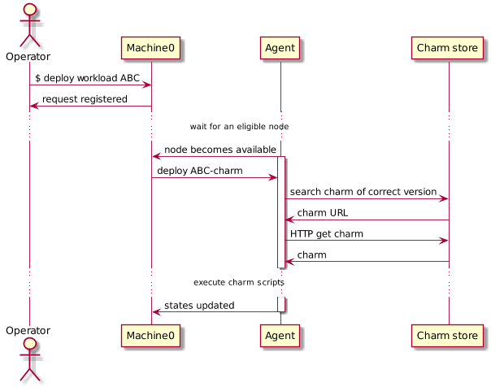
Workload orchestration sequence diagram
Machine-0
Manager node. One per cloud environment. Keep agent states, serve CLI request, and command agents.
Agent
Runtime workload orchestrator. Distributed on each target node.
Charm store
Workload repository. Can be both local & remote.

Slide 32
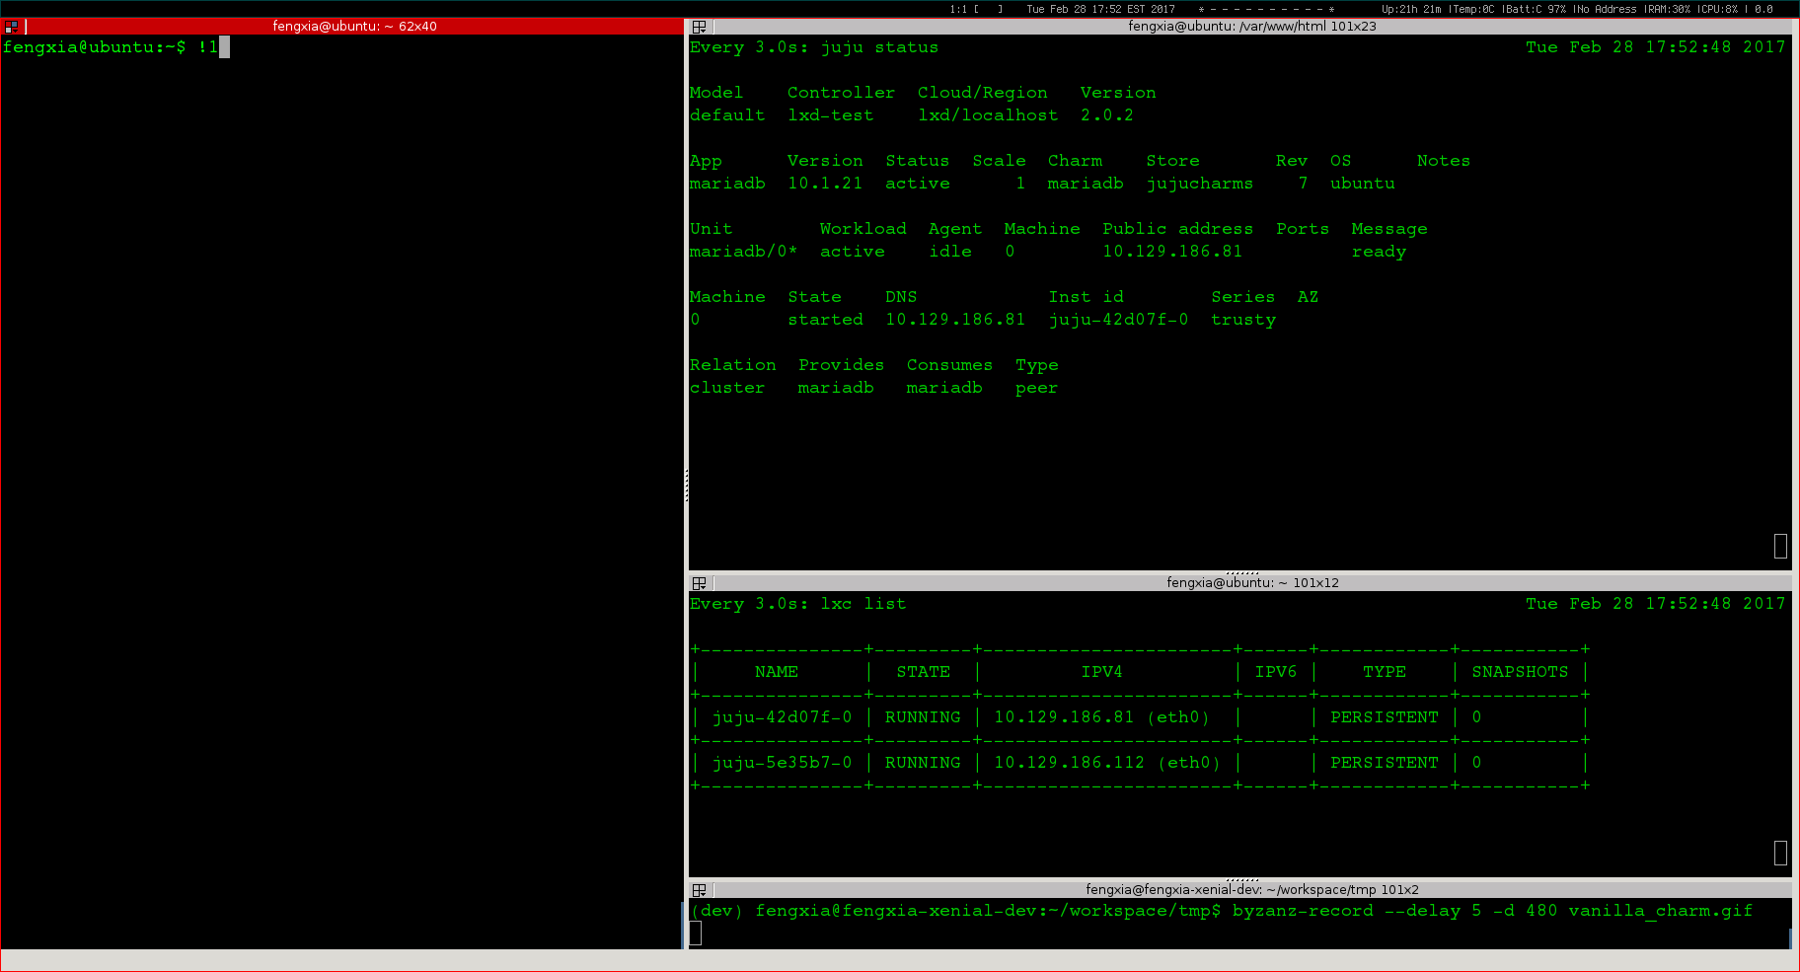
Use case demo: a workload deployment (≈4 min)

Slide 33

System architecture overview
Blueprints
Command to deploy a workload
Hardware
configuration
ie. ThinkAgile
Software platform
Id. Openstack
User application
Ie. Hardoop
Workload metadata
Orchestration manager
3rd party software repo
Baremetal
provider
Cloud provider
ManageIQ
EC2
Ironic
Openstack
XClarity
Rackspace
Node state
Application state
MaaS
Azure
……
……
Platform specific instructions
Workload blueprints
Private Cloud
Public Cloud
Workload software payload

Slide 34
Function Architecture – Level 1
Blueprints
Blueprints
Descriptive template that defines workload states, actions, interfaces, and relations.
Hardware
Ie. ThinkAgile
Platform
Ie. Openstack
User application
Ie. Hadoop
Orchestration
Orchestration technology
Technology that defines terminologies, vocabulary, and runtime engine that enable automated blueprint deployment.
Description language
Orchestration runtime engine
Platform
Platform
Public cloud
Private cloud
Baremetal
Host environment that supports workload requirements and scales dynamically

Slide 35
Level 1 – Blueprints
**Hardware workload
Configure hardware within a hyper-converge rack to establish base line environment such as VLAN, boot sequence.
Blueprints
Platform workload
Hardware
Ie. TA
Platform
Ie. Openstack
User application
Ie. Hadoop
Install OS, agent, and application. Configure system and application to form software-defined platform such as Openstack.
Application workload
Install and configure application and its dependencies.
**
Lenovo innovation

Slide 36
Level 1 – Orchestration technology
Description language
Modeling language written in plain text that describes state, event, component, relation, parameters for installation and configuration.
Orchestration technology
Description language
Orchestration runtime engine
Orchestration runtime
Runtime binary that parse blueprint, responds to state change and event, and execute built-in function and custom scripts.

Slide 37
Level 1 – Platform
Public cloud
Amazon AWS
Azure
Rackspace
GCE
Platform
Private cloud
Public cloud
Private cloud
Baremetal
Openstack
ThinkAgile
Baremetal
Lenovo/xClarity cloud
HP
Dell

Slide 38
Function Architecture – Level 2
Workload Repository
Blueprint store
Workload Service
System optimization & big data
Workload Designer
Design, development and testing tools
Workload Orchestration Runtime System
Orchestration Manager
Central management server, one per platform service
Workload Manager
Distributed agent, one per deployment target
Software Platform Provider
Platform plugin interface & driver
Platform Service Provider
Host environment on demand

Slide 39
Function Architecture – Level 3
Workload Repository
Workload Service
Workload registry
Metadata service
Authentication
Version manager
Configuration filter
Utilization score card
Blueprint pipeline
Workload optimization
Workload Designer
Workload Orchestration Runtime System
Description language
Orchestration Manager
Workload Manager
API server
Node registry
Node lifecycle management
Node auditor
Workload downloader
Workload parser
Template creator
Data store
Configuration manager
Model manager
RPC interface
Workload installer
Workload cleaner
Workload compiler
Cloud provider plugin interface
Constraint checker
Workload version control
Websocket data transporter
State engine
API client
Workload linter
Node authentication
User CA generator
Workload agent provisioner
Worker thread manager
Error handler
Configuration management
Workload packaging mgt
Dry run sandbox
Software Platform Provider
Amazon EC2
GCE
Azure
Opensack
Cloudsigma
Rackspace
Workload editor
Joyent
Vsphere
MAAS
LXD container
Ironic
xClarity
Dependency illustrator
Platform Service Provider
Machine discovery
Machine inspection
Machine inventory
Power mgt
Network service
Storage service
Hypervisor service
Container service

Slide 40
Key Technology

Slide 41
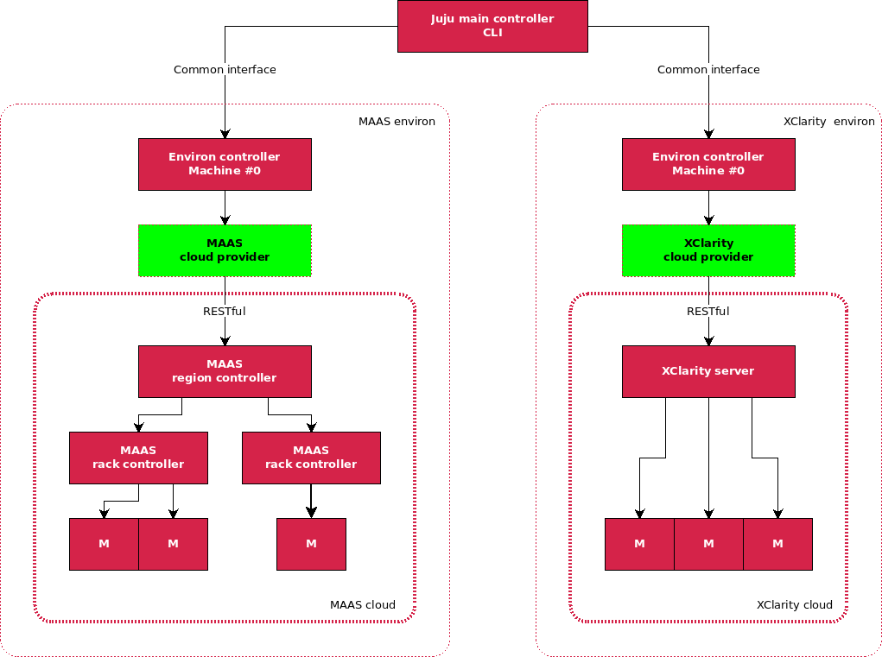
Juju - xClarity cloud model
xClarity cloud
Same configuration to support both public clouds and private cloud.
Extend “provider” to enable integration with xClarity.
Workload becomes “cloud” agnostic.

Slide 42
Workload model (charm)
Workload charm
Base unit is a “service”.
Service can have more than 1 units to achieve HA.
Deployment can be on BM, VM, and LXD container.
High availability

Slide 43
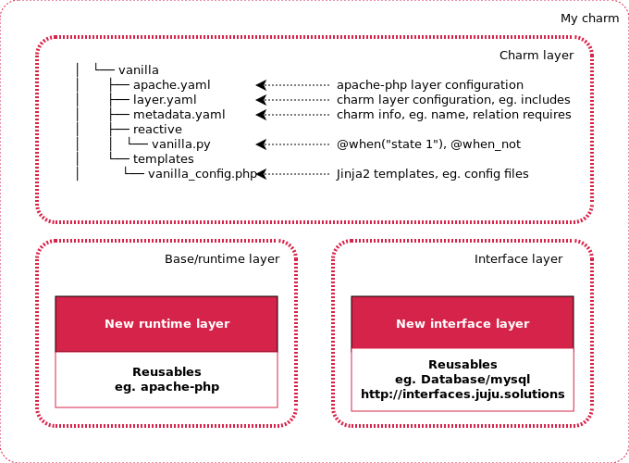
Reactive workload & inheritance
Base layer
Provides foundation service that can be reused.
Interface layer
Defines service that can be “connected” to, eg. DB. Parameters are managed by charm; connection method is determined by the application.
Application layer
Defines “states”, “hooks” and application logics.
Notes:
Base layer
Interface layer defines service that can be “connected” to, eg. DB. Parameters are passed via interface; how to connect is determined by application, not charm.
Charm layer defines “states”, “hooks”, and application logics.

Slide 44
Workload event lifecycle hooks
install
config-changed
start
upgrade-charm
stop
update-status
leader-elected
leader-settings-changed
[name]-relation-joined
[name]-relation-changed
[name]-relation-departed
[name]-relation-broken
[name]-storage-attached
[name]-storage-detaching

Slide 45
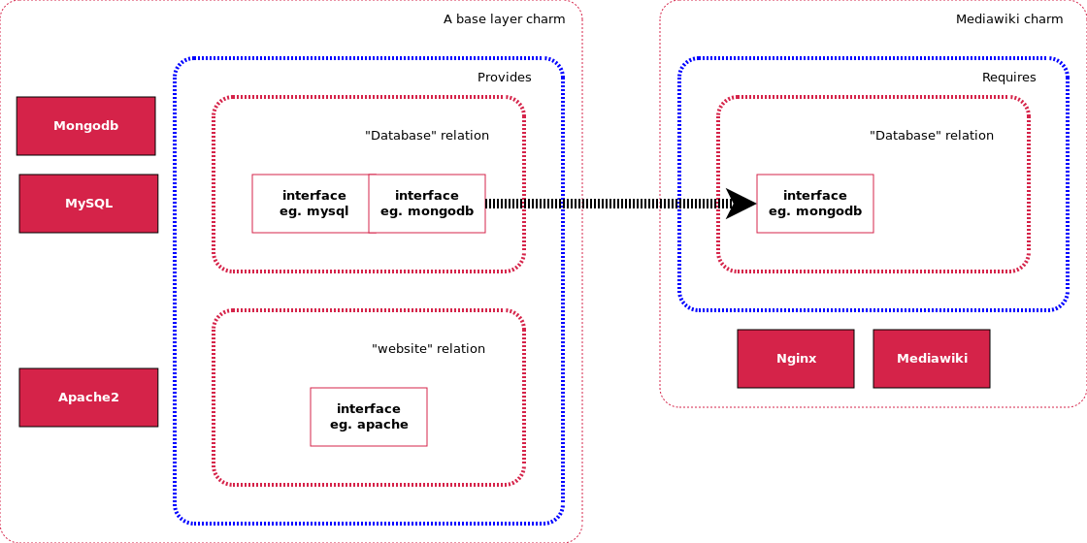
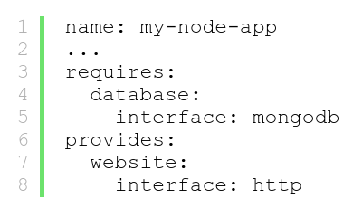
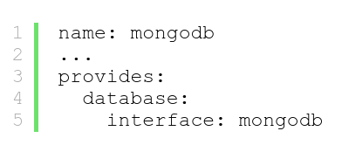
Workload interface sharing
Interface must match
Define a relation category

Slide 46
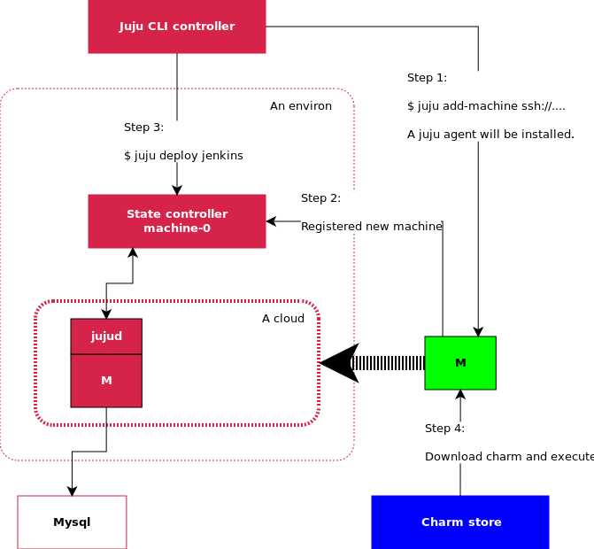
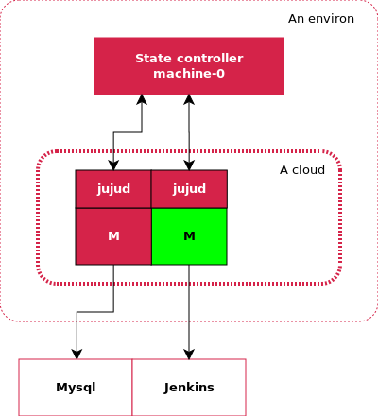
Workload deployment: Before & After
Before
After

Slide 47
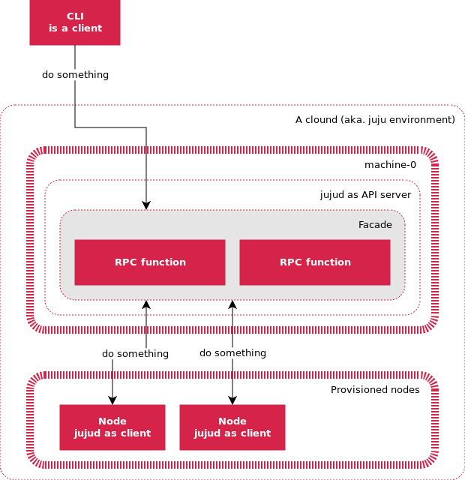
Workload agent
Agent is distributed on each deployment target “machine”.
Agent is installed as part of node provisioning process, then runs as systemd service.
Agent communicates to management node via websocket transportation layer (on server port 17070).
API server provides the same RPC interface for both workload agent and commandline tools.
Agent has a unique ID and credential issued by manager node.

